Slide 1
CUSTOMER CHURN PREVENTION
SYRIA-TEL COMMUNICATIONS

Slide 2
OUTLINE
Customer Service Calls (sign of potential customer unhappiness/churn)
Plan Usage
Churn Across Different Locations
Predicting & Preventing Churn

Slide 3
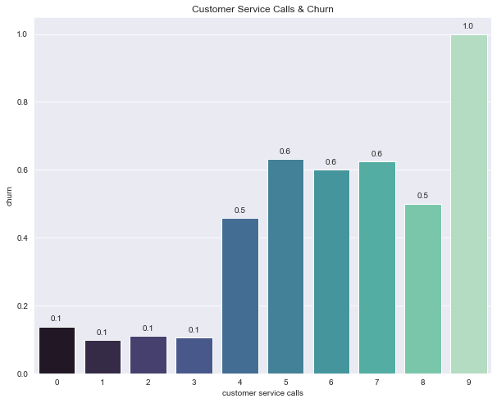
Calls to customer service
Big increase in churn after 3 calls to customer service

Slide 4
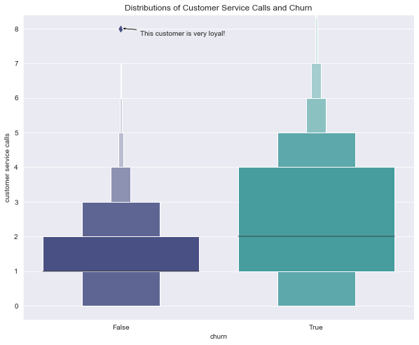
Calls to customer service
Majority of customers who did not churn placed 1-2 calls.
The customers who DID churn placed 1-4 calls

Slide 5
recommendations
Revisit customer service protocol
Offer a large incentive/discount to customers making more than 3 calls to customer service

Slide 6
Plan Usage
Day Rate | Evening Rate | Night Rate | Intl Rate (Plan) | Intl Rate (No Plan)
$0.17/min | $0.08/min | $0.04/min | $0.27/min | $0.27/min
Notice that international rate is same with/without an international plan

Slide 7
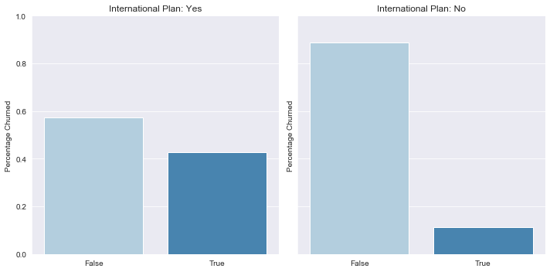
International plan
Higher percentage of Churn with International plan customers

Slide 8
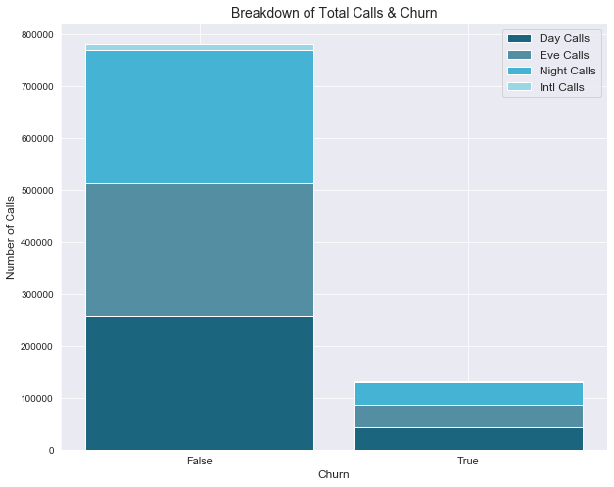
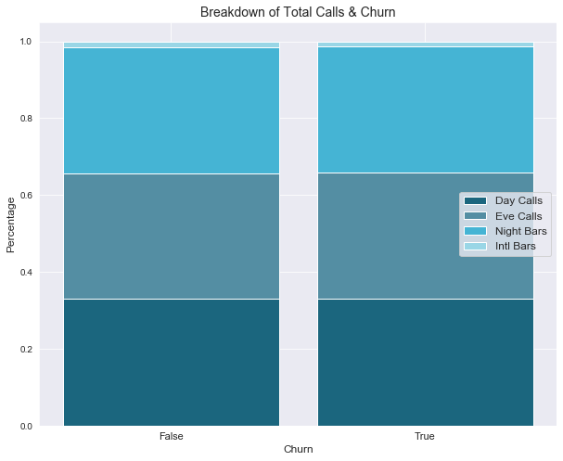
What kinds of calls churn customers are making?
There is virtually no difference between churn and the percentage of day/eve/night/intl calls

Slide 9

Recommendations
Change the rates for international minutes.
If a customer has an international plan, they should
have cheaper rates for international calls than a
customer without an international plan

Slide 10
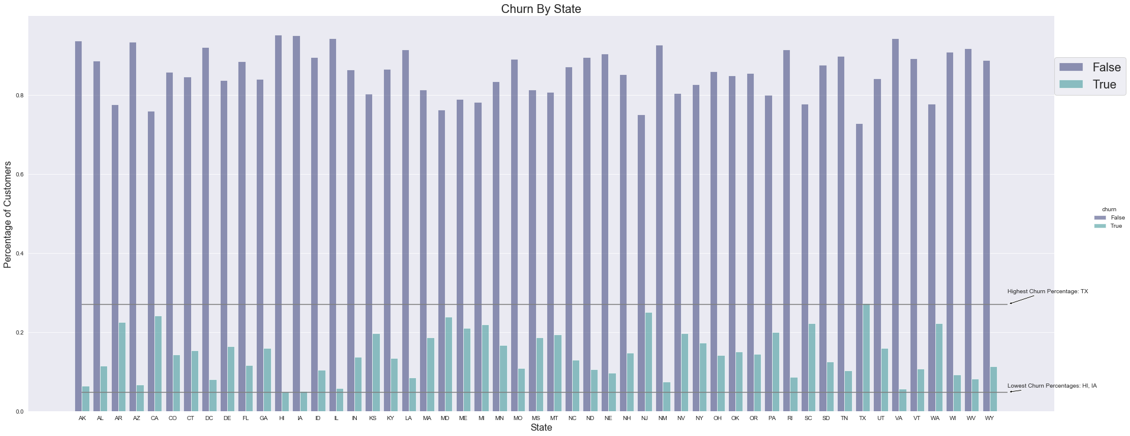
Churn & Customer Location
Highest churn in Texas | Lowest churn in Hawaii and Iowa

Slide 11
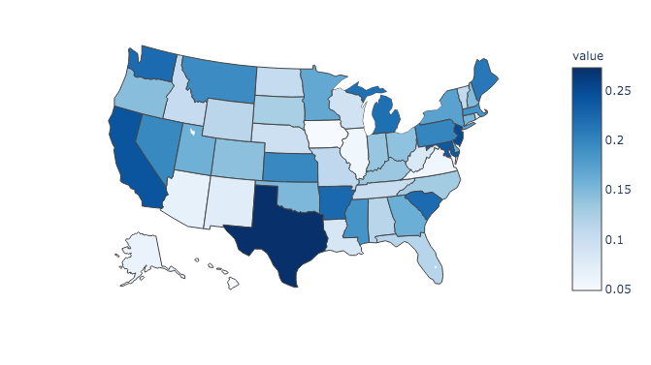
Churn & Customer Location
Highest churn in these states could indicate more competition

Slide 12
Recommendations
Look into competitors in states with high churn to see
if they are offering introductory offers
Look into the cell signal in these states to see if there
are any dead zones contributing to the higher churn

Slide 13
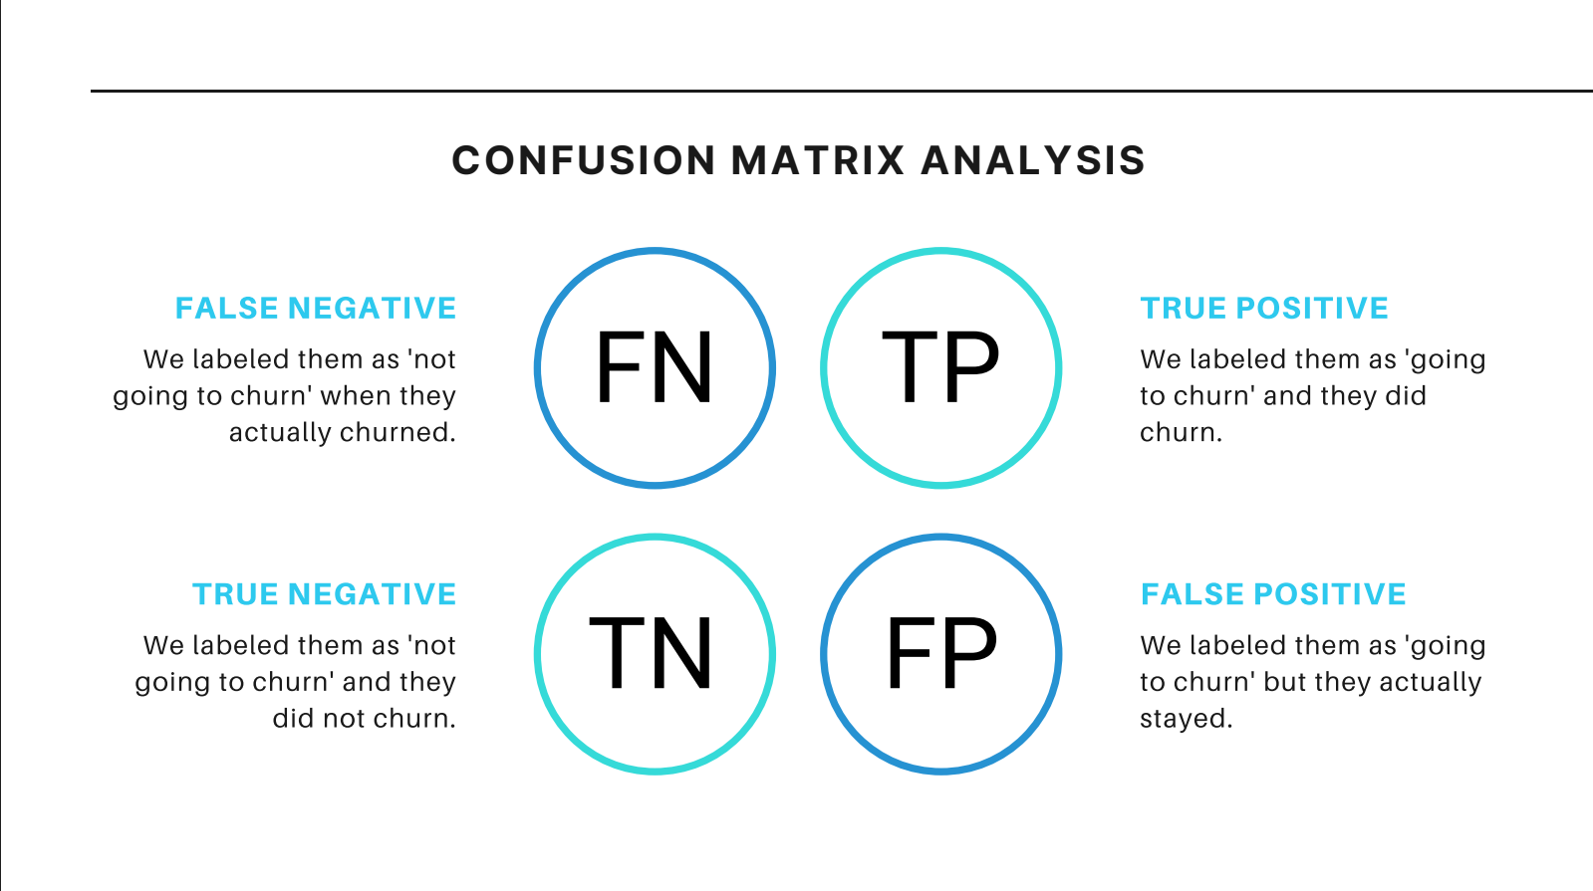

Slide 14
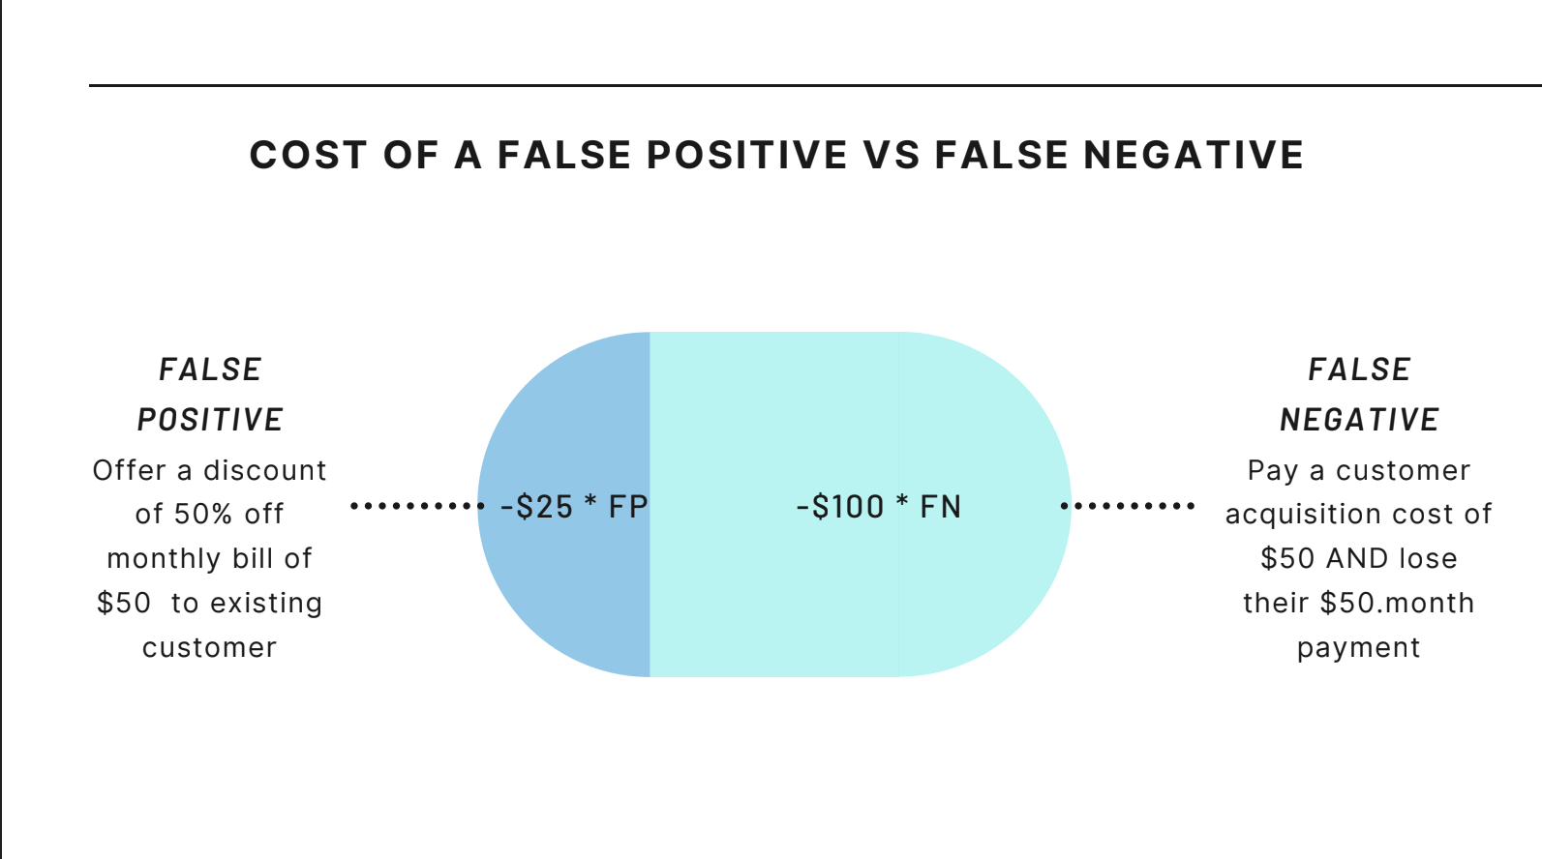

Slide 15
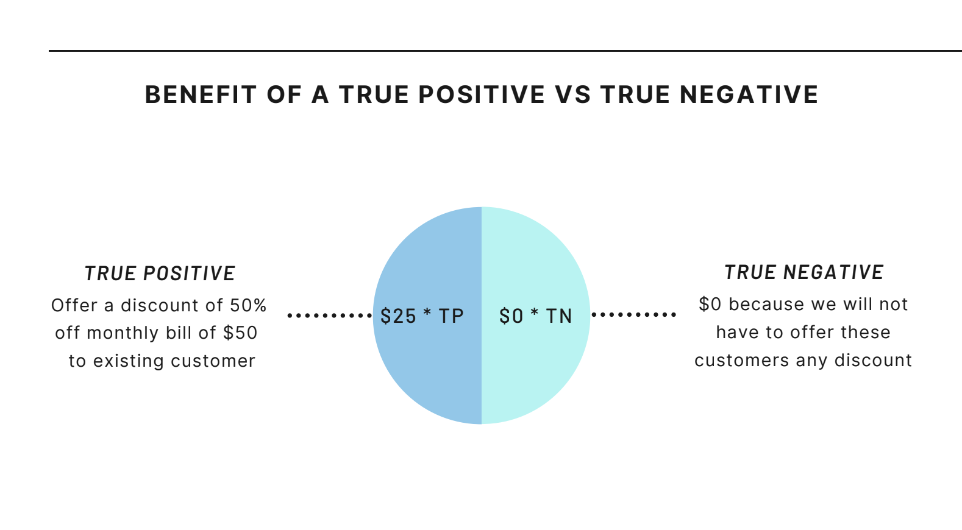

Slide 16
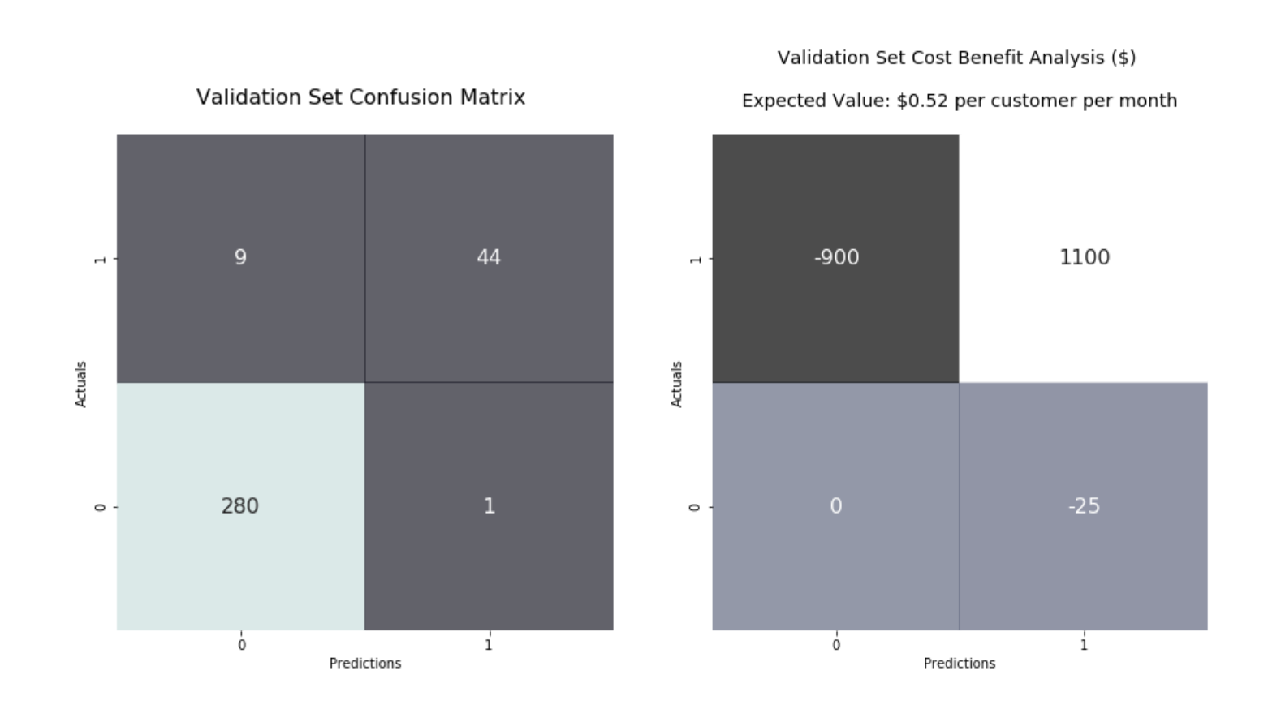

Slide 17
Conclusion & Future work
In conclusion we need to work on 3 main areas :
Customer Service
Intl. Plan
Competition
Future Work:
More data regarding competitors
More data on cell signal across the US
Continue to improve models recall

Slide 18
Thank you
Muhammad Qayyum
wajeeh853@icloud.com
https://github.com/wajeeh853

